Slide 1
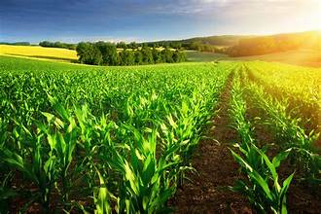
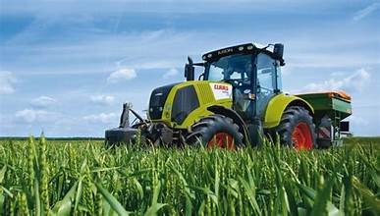
CROP PRODUCTION ANALYSIS IN INDIA

Slide 2
INTRODUCTION
India's agricultural future depends on innovation.
This report explores how the "Future Internet" can transform the sector by fostering collaboration and empowering stakeholders with real-time data insights through a B2B platform.
This approach aims to leverage the big data to optimize crop production.

Slide 3



DETAILS OF DATA
SUM OF PRODUCTION 182.82 M
SUM OF AREA 180.25 M
TOTAL SEASONS 6
TOTAL CROPS 124
TOTAL DISTRICTS 646
TOTAL STATES 33
YEARS 1997 - 2015

Slide 4

MAIN KPI ‘s
PRODUCTION - CROP PRODUCED , PRIMARY MESURE OF AGRICUTURAL SUCCESS .
AREA– LAND AREA DEDICATED TO PARTICULAR CROP.
CROP– ALL THE CROP USED FOR PRODUCTION
SEASON – GROWING CROPS IN DIFFERENT SEASON.
GENSTATE NAME–NAME OF THE ALL THE STATES TAKEN
DISTRICT NAME– NAME OF ALL THE DISTRICT TAKEN

Slide 5
MOCK – UP DASHBOARD
The main goal is to gather constructive feedback to improve the final product
SUM OF PRODUCTION 182.82M
SUM OF AREA 180.25M
TOTAL SEASONS
6
TOTAL CROPS
124
CROP
AREA
DISTRICT
PRODUCTION
CROP YEAR
PRODUCTION
PRODUTION
BY SEASON

Slide 6
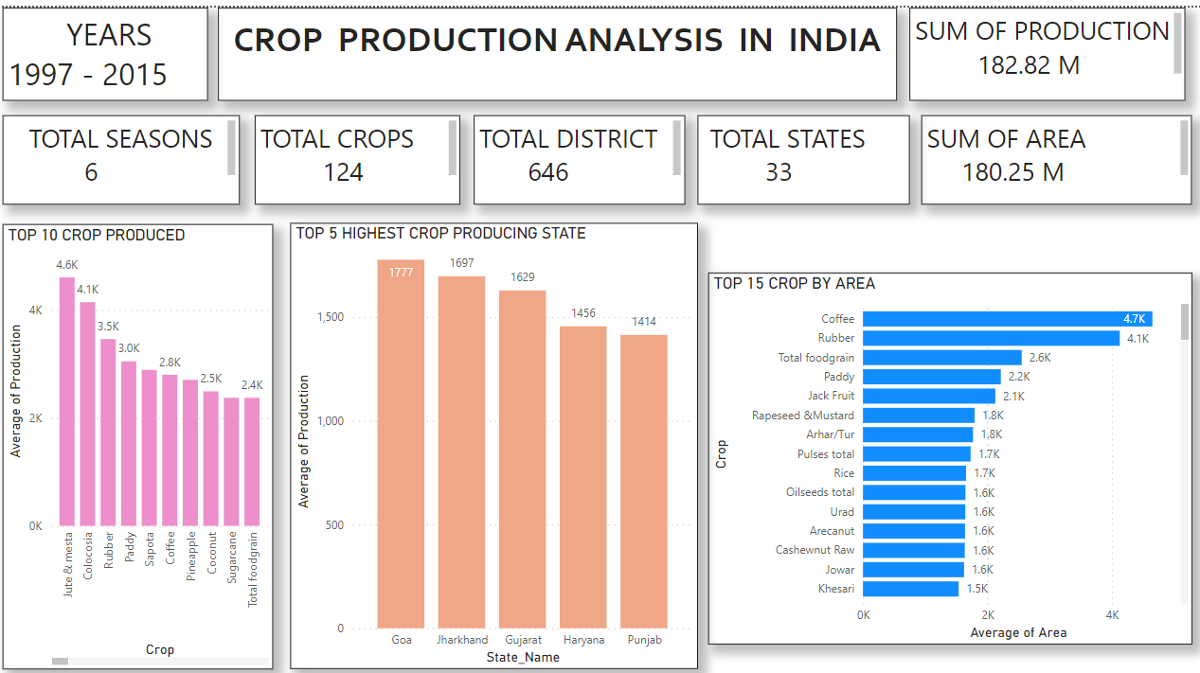
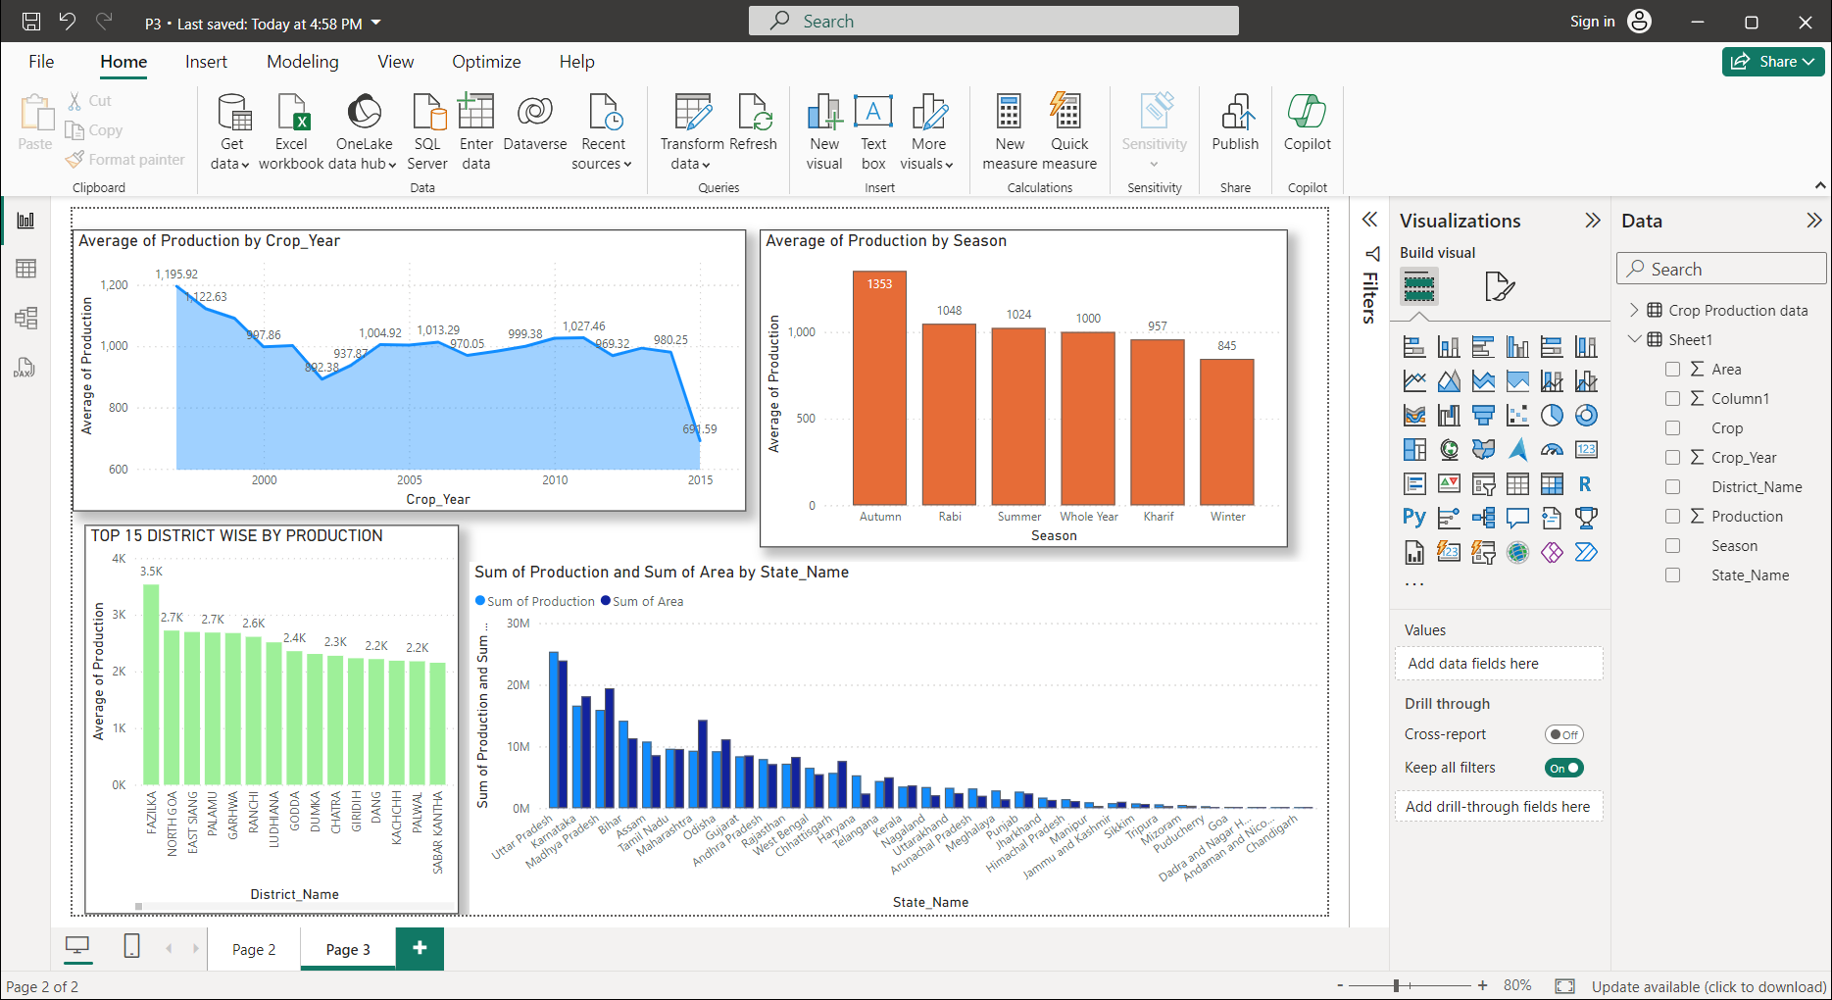
MY DESIGN

Slide 7

Thank you!

